Slide 1

Newspaper Towers
by Robert Chen
Engineering/Construction/Challenge
Elementary or High School
Spring 2013
Notes:
You can change the subtitle to whatever is appropriate.

Slide 2
Challenge and Teaching Points
Challenge
Build the tallest free-standing structure out of newspaper possible.
Can be taped to surface at its base only.
Teaching Points
Triangles are strong
5-step design process
Trial and error construction
Teamwork

Slide 3

Agenda
Intro (10min)
Introduce challenge
Talk about why triangles are strong
Shapes demo
Pleated paper demo
Examples of triangles
5-step engineering design process
Give materials only after they sketch a design

Slide 4
Agenda (con’t)
Build (40min)
4-10 newspapers, your choice
Start with 1 foot of tape
I want tape to be limited to hopefully foster creativity
Recap (5min)
Point out where they used triangles effectively
Give them positive feedback about what they did to create strong structures

Slide 5
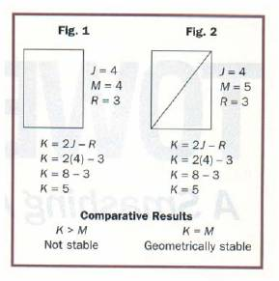
Why are triangles strong?
Fewer degrees of freedom than many other shapes
Given sides of constant length, you can’t change angles of a triangle
Force on a triangle goes into the material of the sides and the strength of the pivot in the joints
K = 2J – 3
M = number of members (beams)
J = number of joints
R = 3, number of sides of triangle
K = M, stable
K > M, unstable
K < M, indeterminate

Slide 6
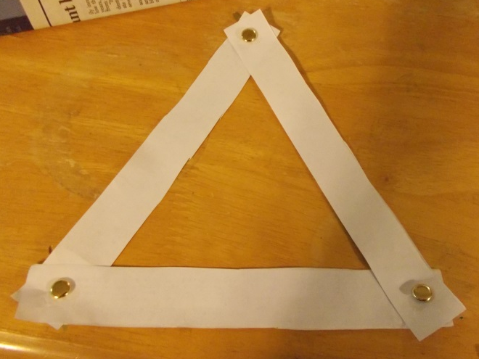
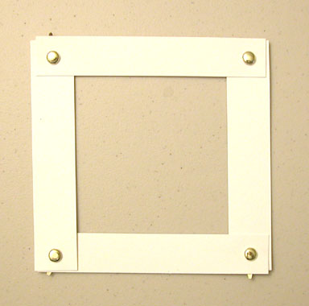
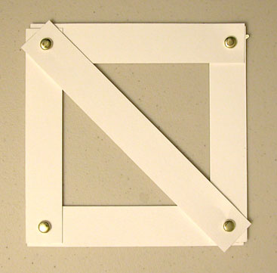
Shapes demo
Point is to show that you can deform a square, but not triangles.
We will make these with cardboard and the fasteners later. Bring them to your site.

Slide 7
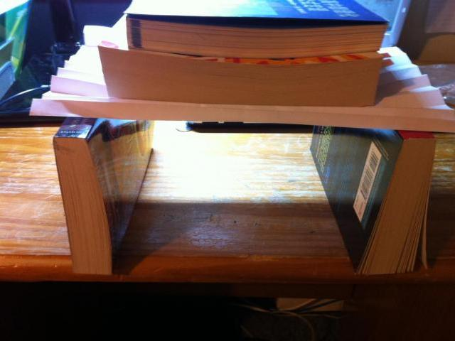
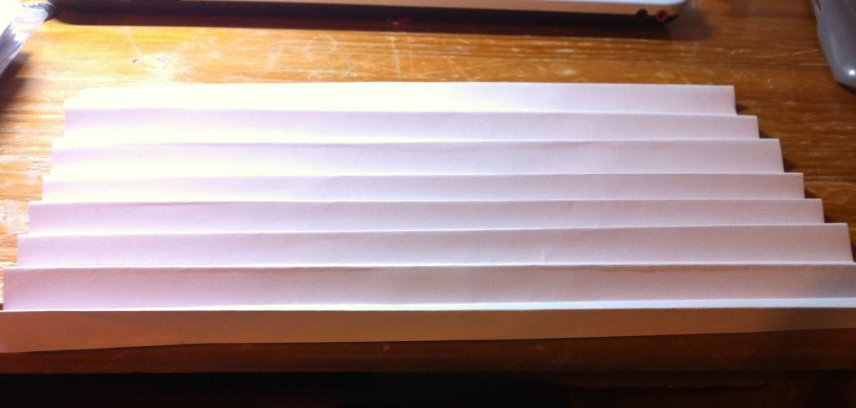
Pleated paper demo
Point is to show that force can be distributed over many triangles to be fairly strong.

Slide 8
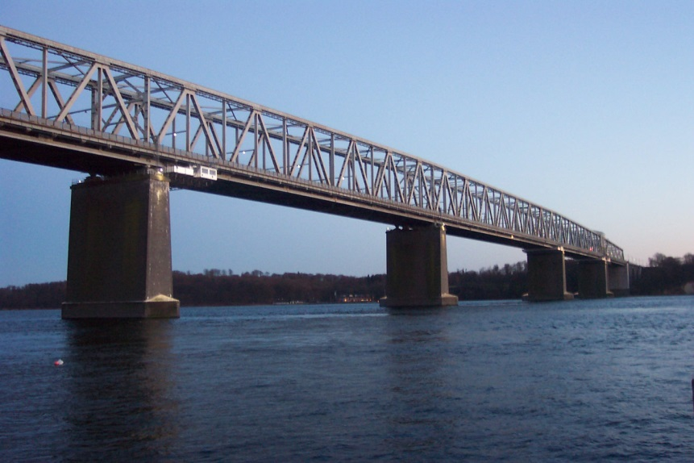
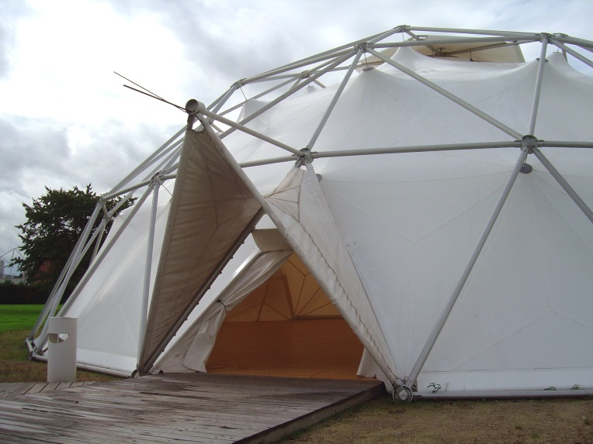

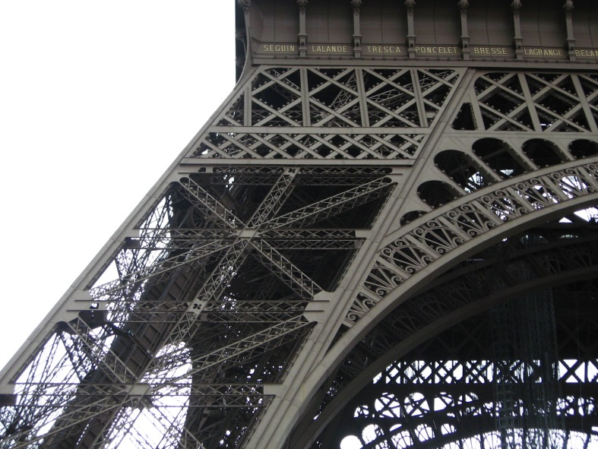
Examples of triangles

Slide 9
5-step engineering design process
Ask what makes a good tower
Imagine possible designs
Plan tower on paper
Create out of newspaper
Improve it

Slide 10
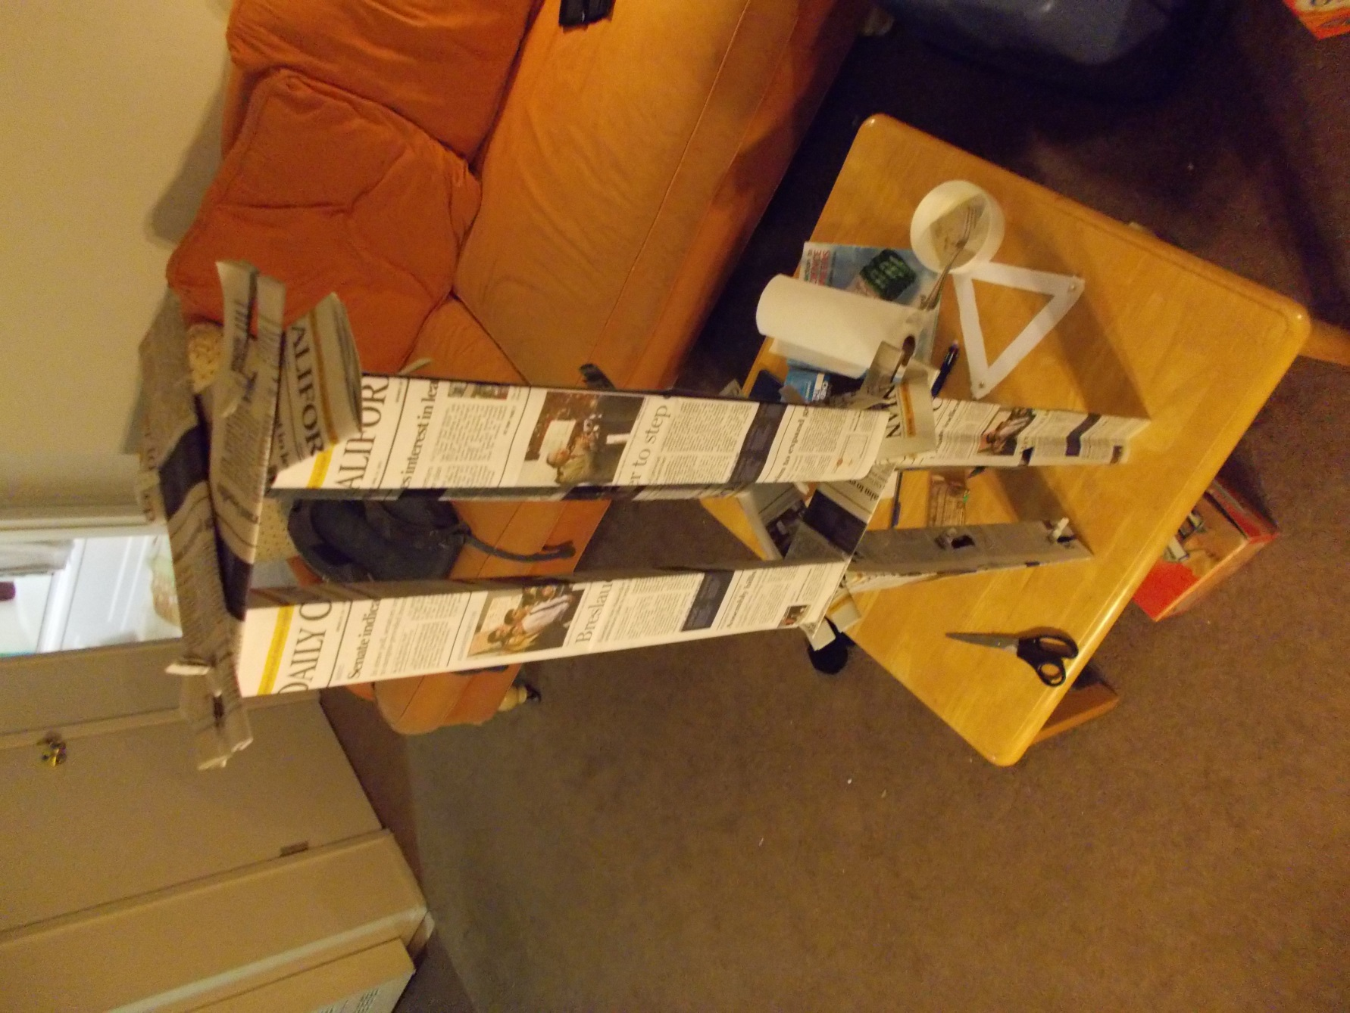
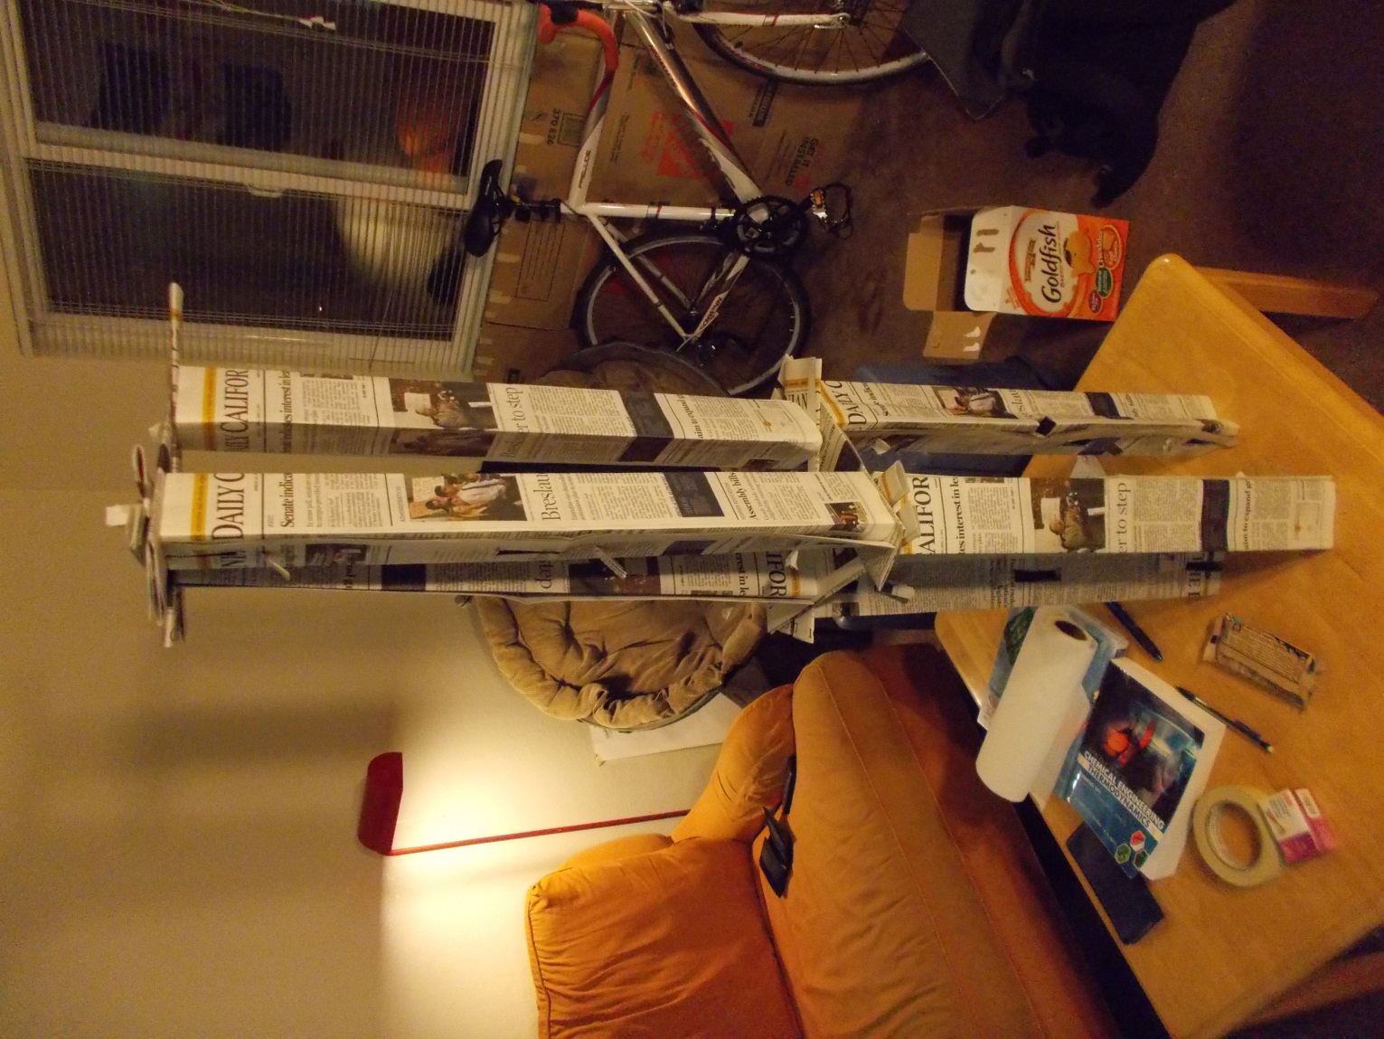
A tower made with no tape, just 9 newspapers

Slide 11
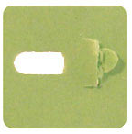
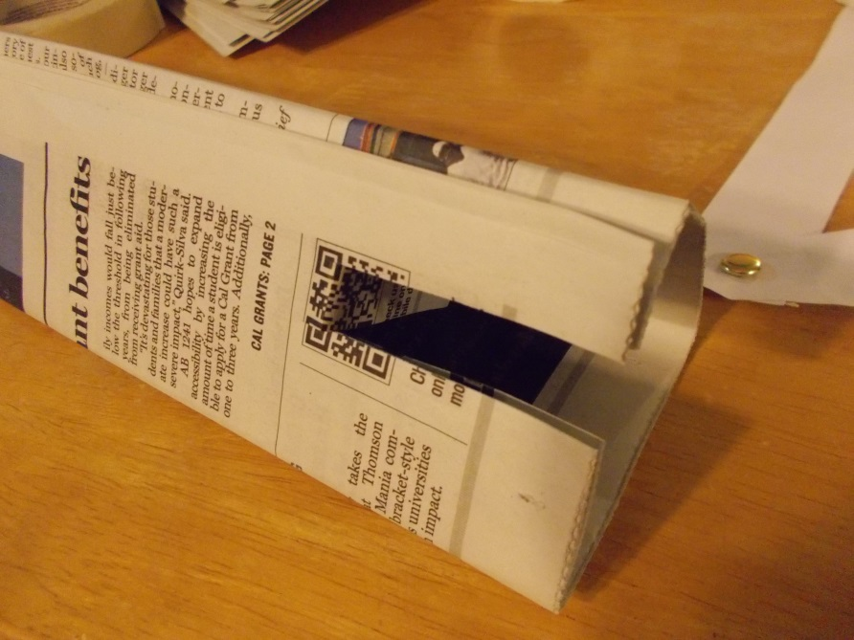
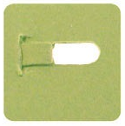
Fastening without tape
Front
Back

Slide 12
Every site grab…
Cardboard
6 newspapers
11 fasteners
Scissors
Foot of tape

